Slide 1
Lecture 4-5
MODELING THE SOFTWARE PROCESS

Slide 2
What Do We Mean by a Process?
Is a series of steps involving activities, constraints, and resources to produce an intended output
Prepare for exams
Conduct a software competition
Organize a trip
Write a term project report
Involves a set of tools and techniques
Block diagrams
Notations

Slide 3
How is a Process Useful?
Impose consistency and structure on a set of activities
Guide us to understand, control, examine, and improve the activities
Enable us to capture our experiences and pass them along

Slide 4
Characteristics of a Process
Prescribes all major process activities
Uses resources, subject to set of constraints (such as schedule)
Produces intermediate and final products
May be composed of sub-processes with hierarchy or links
Each process activity has entry and exit criteria
Activities are organized in sequence, so timing is clear
Each process guiding principles, including goals of each activity
Constraints may apply to an activity, resource or product

Slide 5
Characteristics of a Process
Prescribes all major process activities
Uses resources, subject to set of constraints (such as schedule)
Produces intermediate and final products
May be composed of sub-processes with hierarchy or links
Each process activity has entry and exit criteria
Activities are organized in sequence, so timing is clear
Each process guiding principles, including goals of each activity
Constraints may apply to an activity, resource or product

Slide 6
Software Lifecycle
When a process involves building a software (product), the process may be referred to as software (product) lifecycle
Requirements analysis and definition
System (architecture) design
Program (detailed/procedural) design
Writing programs (coding/implementation)
Testing: unit, integration, system
System delivery (deployment)
Maintenance

Slide 7
What is a Process Model?
Description of a process, evolved overtime, in a certain format
May use text, pictures, or a combination
Contains key process features

Slide 8
Why is a Process Model Needed?
To form a common understanding
To find inconsistencies, redundancies, omissions
To find and evaluate appropriate activities for reaching process goals
To tailor a general process for a particular situation in which it will be used

Slide 9
What is a Software Process Model?
Models that prescribe how should development of software progress
Models that describe how is software developed in actuality

Slide 10
Software Development Process Models
Waterfall model
V model
Prototyping model
Operational specification
Transformational model
Phased development: increments and iteration
Spiral model
Unified process
Agile methods

Slide 11
Waterfall Model
One of the first process development models proposed
Works for well understood problems with minimal or no changes in the requirements
Simple and easy to explain to customers
It presents
a very high-level view of the development process
sequence of process activities
Each major phase is marked by milestones and deliverables (artefacts)

Slide 12
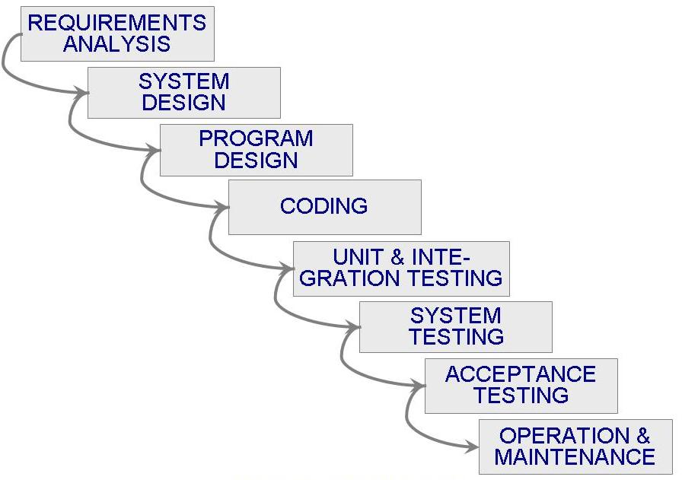
Waterfall Model (Contd.)

Slide 13
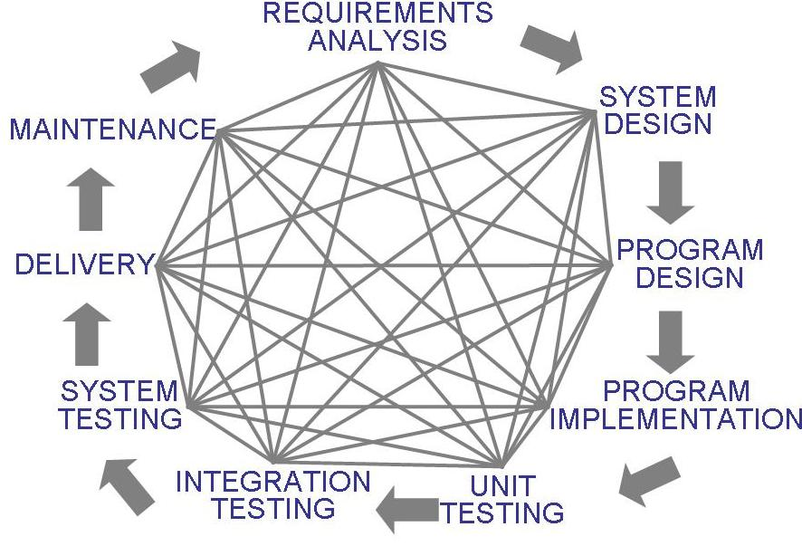
Waterfall Model (Contd.)
Uncontrolled Software Development Process
No Iterations in WF

Slide 14
Waterfall Model (Contd.)
Provides no guidance how to handle changes to products and activities during development (assumes requirements can be frozen)
Views software development as manufacturing process rather than as creative process
There is no iterative activities that lead to creating a final product
Long wait before a final product
Generates lots of documentation
Suitable for large projects

Slide 15
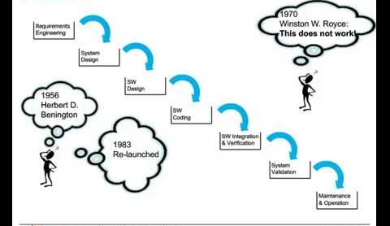

Slide 16
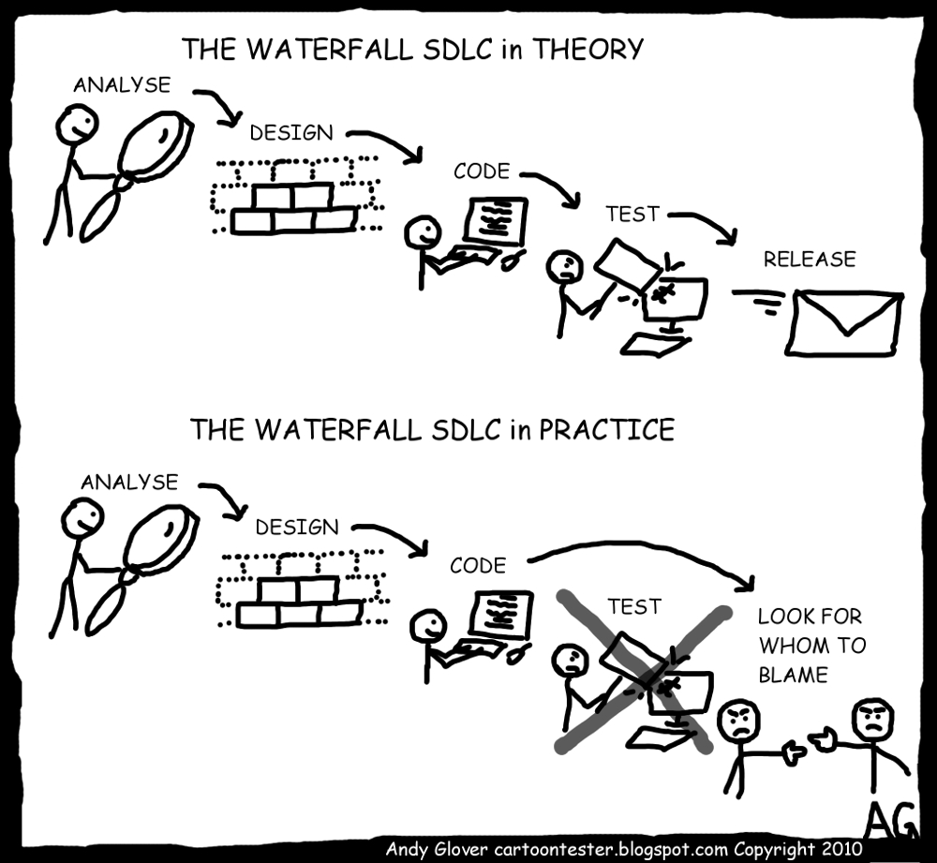

Slide 17
Waterfall Model with Prototyping
A prototype is a partially developed product
Prototyping helps
developers assess alternative design strategies (design prototype)
users understand what the system will be like (user interface prototype)

Slide 18
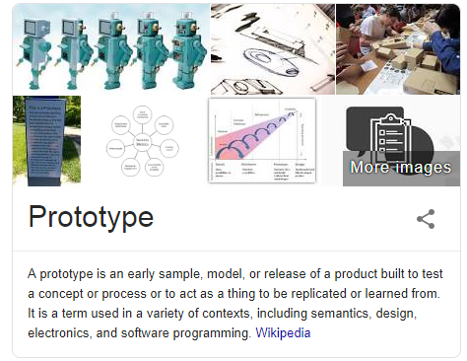

Slide 19
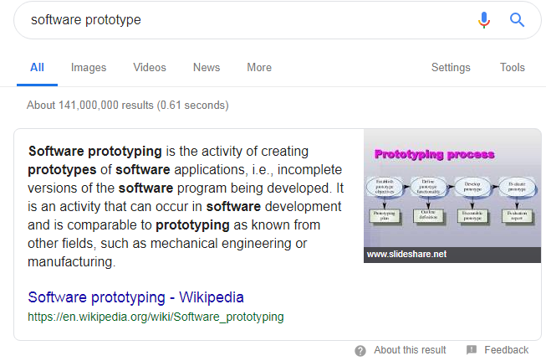

Slide 20
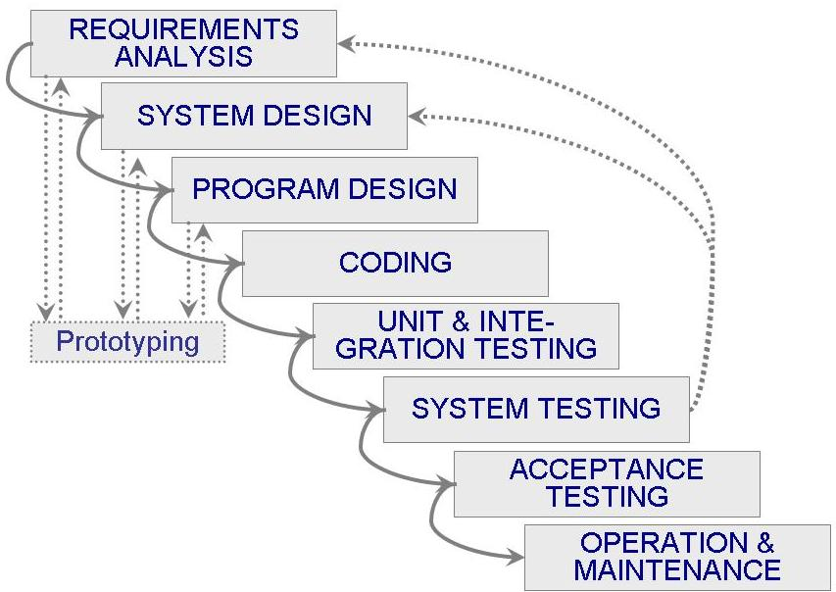
Waterfall Model with Prototyping

Slide 21
V Model
A variant of the waterfall model
Uses unit testing to verify procedural design
Uses integration testing to verify architectural (system) design
Uses acceptance testing to validate the requirements
If problems are found during verification and validation, the left side of the V can be re-executed before testing on the right side is re-enacted

Slide 22
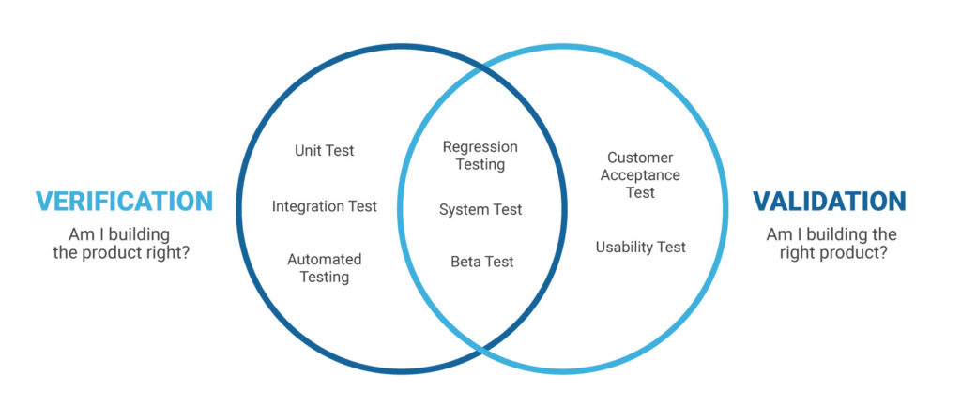

Slide 23
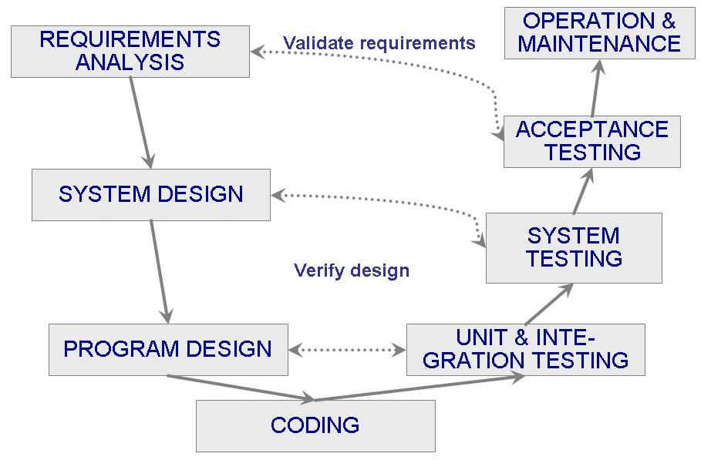
V Model (Contd.)

Slide 24
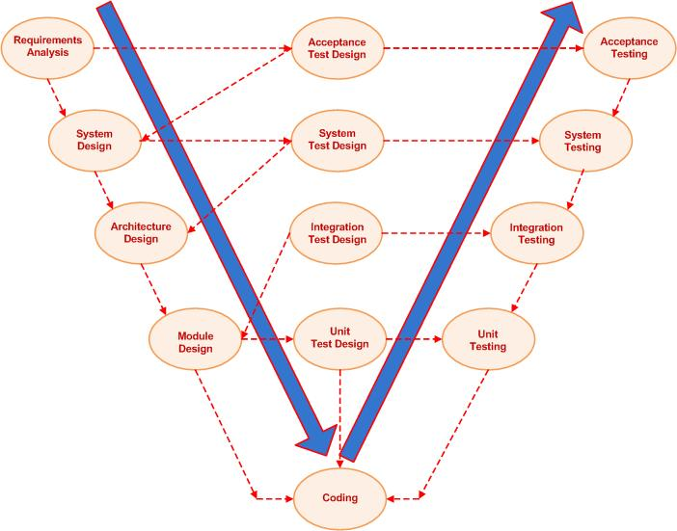

Slide 25
The main difference between waterfall model and V model is that in waterfall model, the testing activities are carried out after the development activities are over. On the other hand in V model, testing activities start with the first stage itself. In other words, waterfall model is a continuous process, while the V model is a simultaneous process. As compared to a software made using waterfall model, the number of defects in the software made using V model are less. This is due to the fact, that there are testing activities, which are carried out simultaneously in V model. Therefore, waterfall model is used, when the requirements of the user are fixed. If the requirements of the user are uncertain and keep changing, then V model is the better alternative.

Slide 26
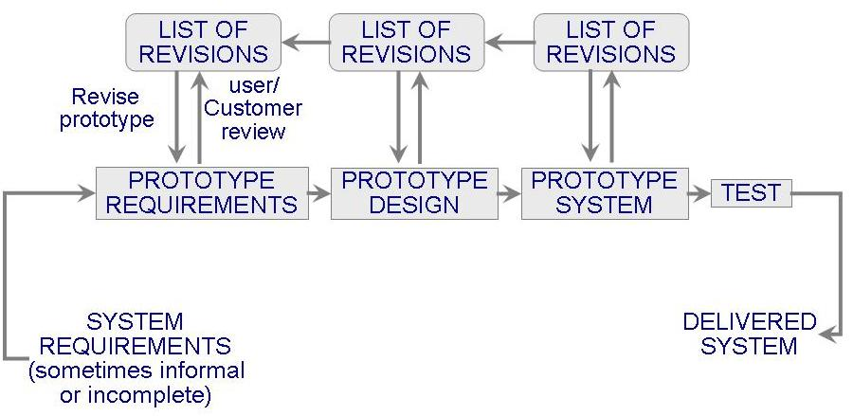
Prototyping Model
Allows repeated investigation of the requirements or design
Reduces risk and uncertainty in the development

Slide 27
Prototyping Model (Contd.)
Types:
Evolutionary
Throwaway
Features
User involvement?
Smaller projects?

Slide 28
Phased Development
Cycle time
Time between when requirements document was written and when the system was delivered
Shorter cycle time
Decomposed system
System delivered in pieces
enables customers to have some functionality while the rest is being developed
Two systems functioning in parallel
the production system (release n): currently being used
the development system (release n+1): the next version

Slide 29
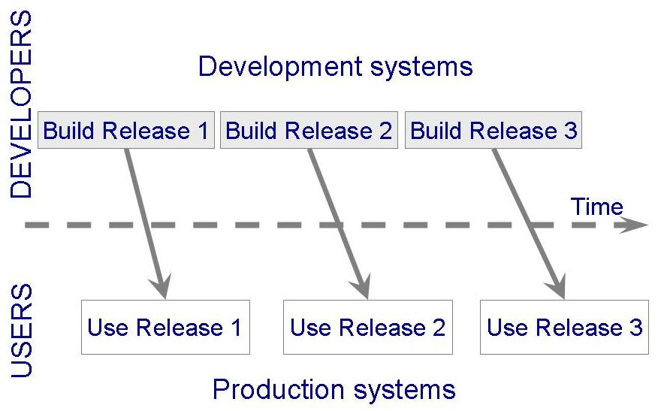
Phased Development (Contd.)

Slide 30
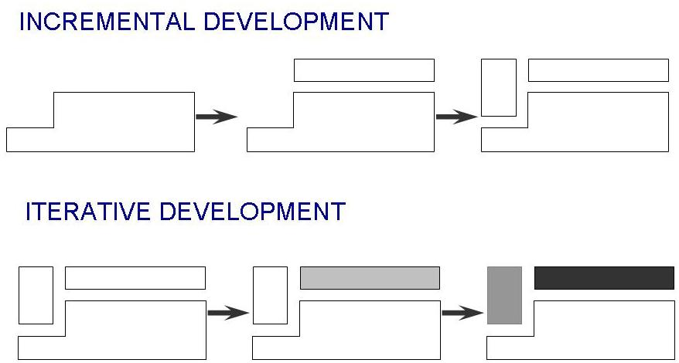
Phased Development (Contd.)
Incremental development: starts with small functional subsystem and adds functionality with each new release
Iterative development: starts with full system, then changes functionality of each subsystem with each new release

Slide 31
Phased Development (Contd.)
Training on early release
Responsive developers
Markets for early functionality
Quick and Global fixing on unanticipated problems
Ability to work on different areas of expertise with different releases

Slide 32
Lecture 5

Slide 33
Spiral Model
Suggested by Boehm (1988)
Combines development activities with risk management to minimize and control risks
The model is presented as a spiral in which each iteration is represented by a circuit around four major activities
Plan
Determine goals, alternatives and constraints
Evaluate alternatives and risks
Develop and test

Slide 35
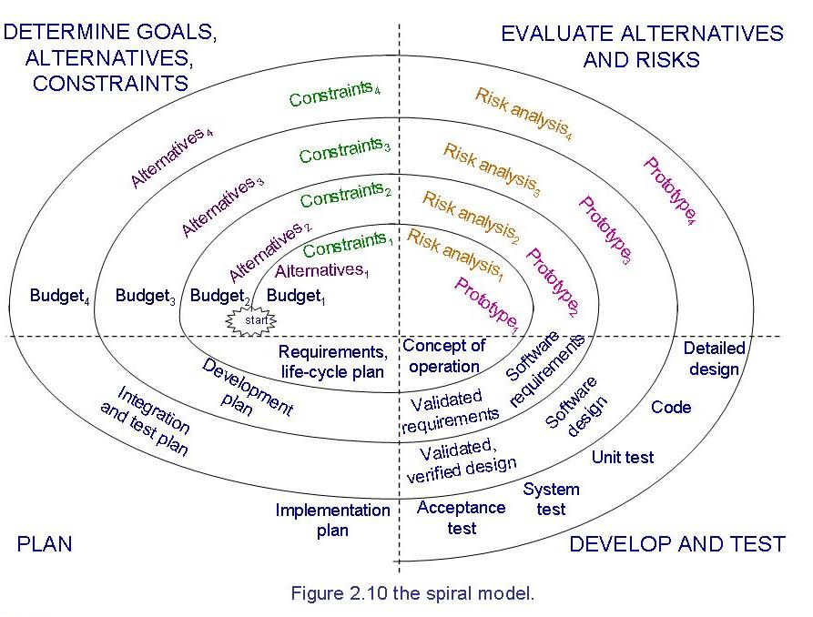
Spiral Model (Contd.)

Slide 38
Agile Methods
Emphasis on flexibility in producing software quickly and capably in rapidly changing environment
Agile manifesto
Concentrate on responding to change rather than on creating a plan and then following it (chaordic)
Value individuals and interactions over process and tools
Prefer to invest time in producing working software rather than in producing comprehensive documentation
Focus on customer collaboration rather than contract negotiation

Slide 39
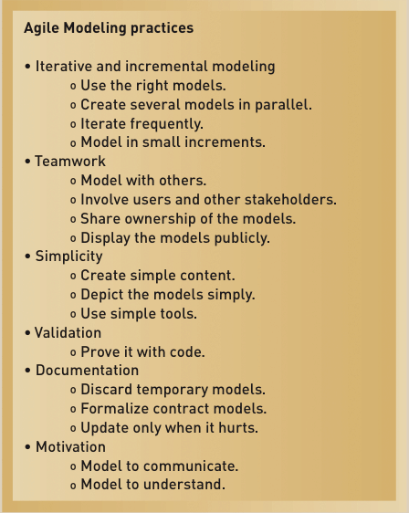
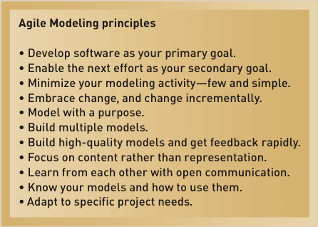
Agile Methods

Slide 40
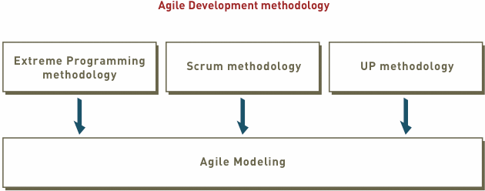
Agile Methods (Contd.)

Slide 42
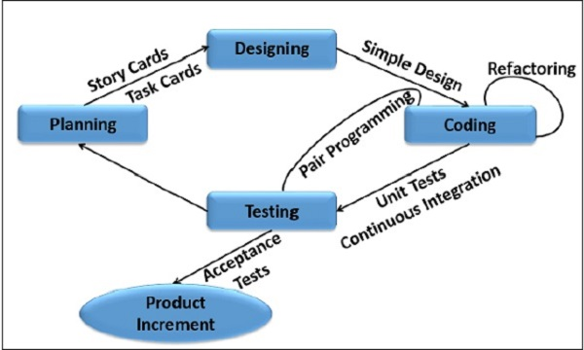

Slide 43
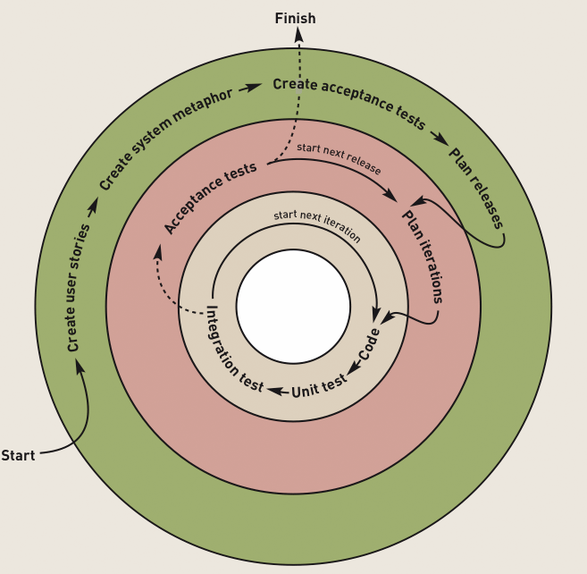
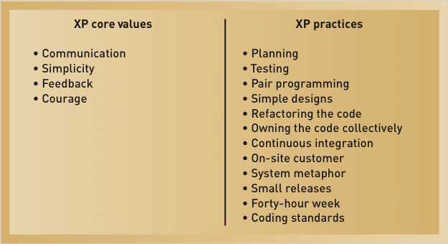
Agile Methods (Contd.)
Extreme Programming (XP)
XP Development Approach

Slide 44
Pair programming
Pair programming is an agile software development technique in which two programmers work together at one workstation. One, the driver, writes code while the other, the observer or navigator,^{[1]} reviews each line of code as it is typed in. The two programmers switch roles frequently.
While reviewing, the observer also considers the "strategic" direction of the work, coming up with ideas for improvements and likely future problems to address. This is intended to free the driver to focus all of their attention on the "tactical" aspects of completing the current task, using the observer as a safety net and guide.

Slide 45
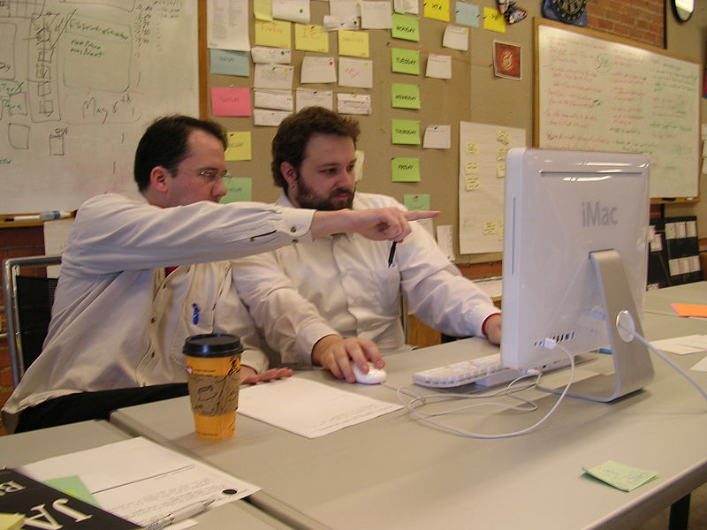

Slide 46
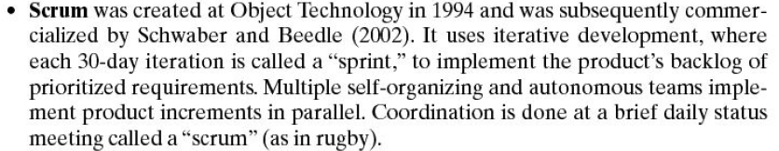

Slide 47
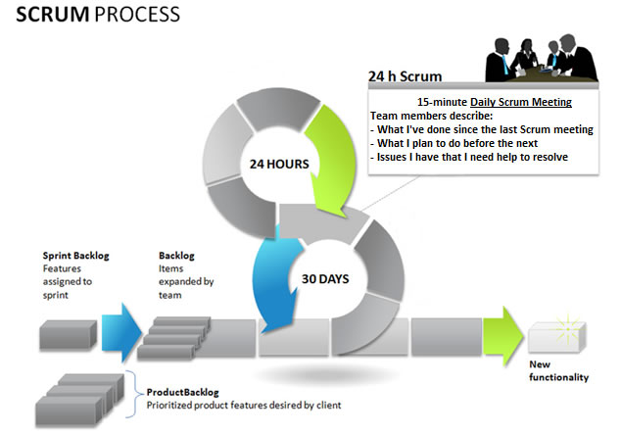

Slide 48
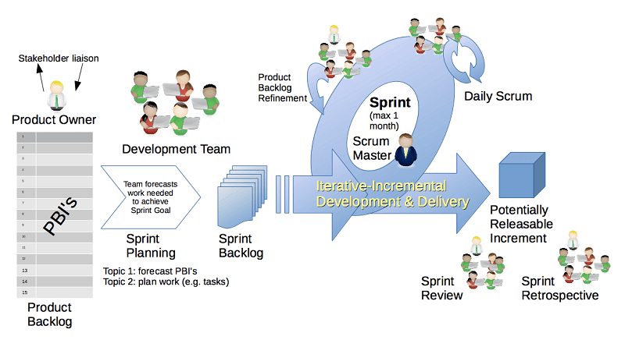

Slide 49
Agile Methods (Contd.)
Scrum:
A quick, adaptive, and self-organizing development methodology
Responds to a current situation as rapidly and positively as possible

Slide 50
Agile Methods (Contd.)
Scrum Philosophy
Responsive to a highly changing, dynamic environment
Focuses primarily on the team level
Team exerts total control over its own organization and work processes
Uses a product backlog as the basic control mechanism
Prioritized list of user requirements used to choose work to be done during a Scrum project

Slide 51
Agile Methods (Contd.)
Scrum Organization
Product owner
The client stakeholder for whom a system is being built
Maintains the product backlog list
Scrum master
Person in charge of a Scrum project
Scrum team or teams
Small group of developers
Set their own goals and distribute work among themselves

Slide 52
Agile Methods (Contd.)
Scrum Practices
Sprint
The basic work process in Scrum
A time-controlled mini-project
Firm 30-day time box with a specific goal or deliverable
Parts of a sprint
Begins with a one-day planning session
A short daily Scrum meeting to report progress
Ends with a final half-day review

Slide 53
Unified Process Model (Contd.)
UP life cycle:
Includes four phases which consist of iterations
Iterations are “mini-projects”
Four Phases:
Inception – develop and refine system vision
Elaboration – define requirements and design and implement core architecture
Construction – continue design and implementation of routine, less risky parts
Transition – move the system into operational mode

Slide 54
Unified Process Model
Object-oriented system development methodology (system development process)
Offered by Rational/IBM, UP developed by Booch, Rumbaugh, and Jacobson
UP should be tailored to organizational and project needs
Highly iterative life cycle
Project will be use-case driven and modeled using UML

Slide 55
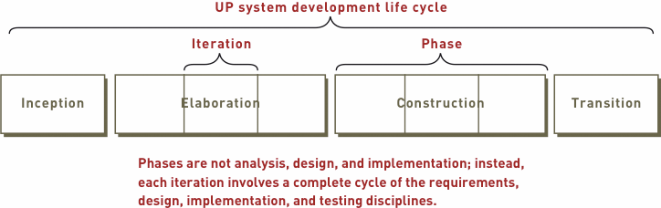
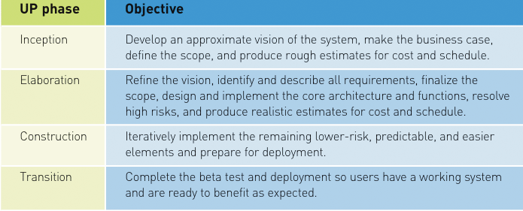
Unified Process Model (Contd.)
Images’ Source: Systems Analysis and Design in a Changing World, 4th Edition

Slide 56
Unified Process Model (Contd.)
Related development activities are called disciplines
UP disciplines:
Business modeling, requirements, design, implementation, testing, deployment, project management, configuration and change management, and environment
Each iteration includes activities from all disciplines
Activities in each discipline produce artefacts – models, documents, source code, and executables

Slide 57
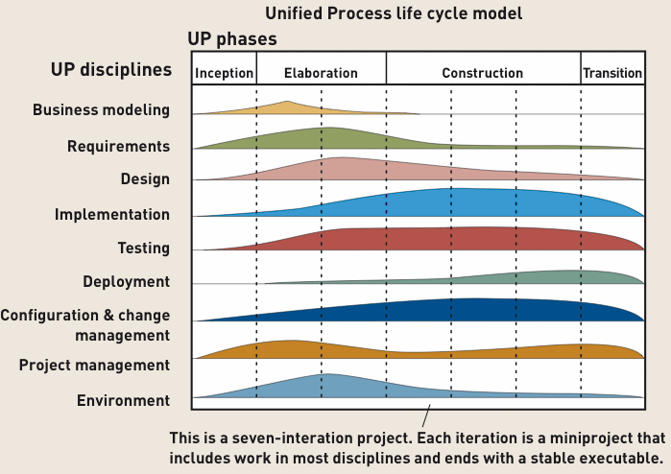
Unified Process Model (Contd.)
Image Source: Systems Analysis and Design in a Changing World, 4th Edition

Slide 58
References
Book slides from UCF
Disclaimer!
A few slides have been reused from UCF slides for the SE course

Slide 59
A person write code according to the diagrams.
Analyst
Designer
Programmer
Tester
Trainer

Slide 60
A person makes diagrams according to customer requirement
Analyst
Designer
Programmer
Tester
Trainer

Slide 61
A person makes diagrams according to customer requirement
Analyst
Designer
Programmer
Tester
Trainer

Slide 62
A person who listens and bears the client and writes technical document
Analyst
Designer
Programmer
Tester
Trainer

Slide 63
The water fall model can be used in
Craft
Manufacturing
Commercial Production
Engineering
All
None

Slide 64
The water fall model can not be used in
Craft
Manufacturing
Commercial Production
Engineering
All
None

Slide 65
I am building the right product.. What customer wants
Validation
Verification
Both
none

Slide 66
I am building the product in right way according to the design
Validation
Verification
Both
none

Slide 67
In improving waterfall model, we involved _______ in V model
customer
user
Testing teams in initial stage
All
none

Slide 68
We deliver part of a project at each phase in
Prototyping model
Spiral model
Phased development model
All
none

Slide 69
We conduct risk analysis, and evaluate constrains at each step
Prototyping model
Spiral model
Phased development model
All
none

Slide 70
We show the mini model or stub of final product at each step
Prototyping model
Spiral model
Phased development model
All
none

Slide 71
We involve customer at each step
Prototyping model
Spiral model
Phased development model
All
none

Slide 72
The throwaway stubs are developed in
Prototyping model
Spiral model
Phased development model
All
none

Slide 73
The evolutionary stubs are developed in
Prototyping model
Spiral model
Phased development model
All
none

Slide 74
We may have to compromise on quality in case
Evolutionary stub
Throw away stub
All
none

Slide 75
We may have to compromise on time in case
Evolutionary stub
Throw away stub
All
none

Slide 76
If there are more chances of rejection we should go for
Evolutionary stub
Throw away stub
All
none

Slide 77
With the passage of time, we going for___
Documentation based models
Agile models with less documentation and more focus on work
All
none

